Slide 1
Three Keywords, Five Rules
OR
Addition rule
Special addition rule
Exclusive
NOT
Subtraction rule
AND
Multiplication rule
Special multiplication rule
Independent

Slide 2

Event Space
P(event) = 1.0

Slide 3
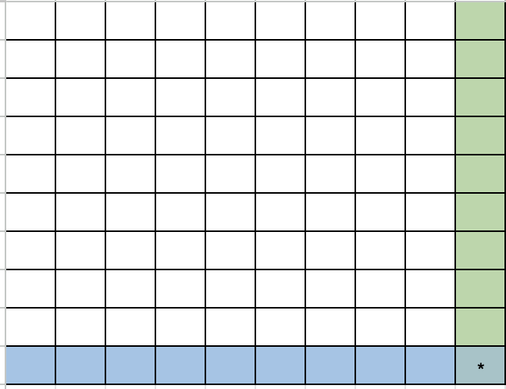
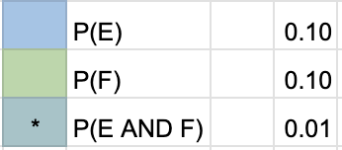
Addition Rule: P(E or F)
= P(E) + P(F) - P(E and F)
= .1+.1-.01
= .19

Slide 4
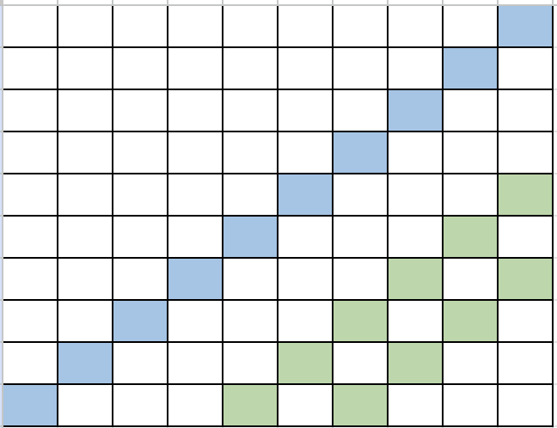

Special Addition Rule: P(E or F)
= P(E) + P(F)
= .1+.1
= .2

Slide 5
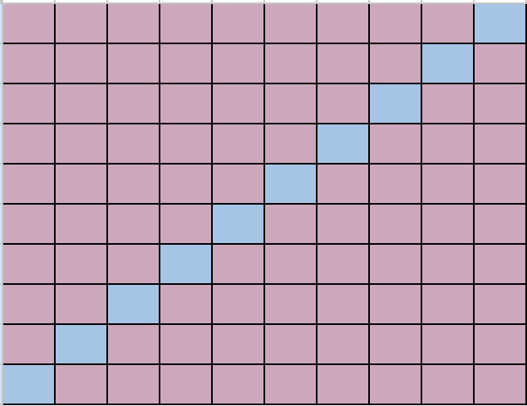
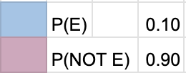
Subtraction Rule: P(not E)
= 1 - P(E)
= 1-.1
= .9

Slide 6
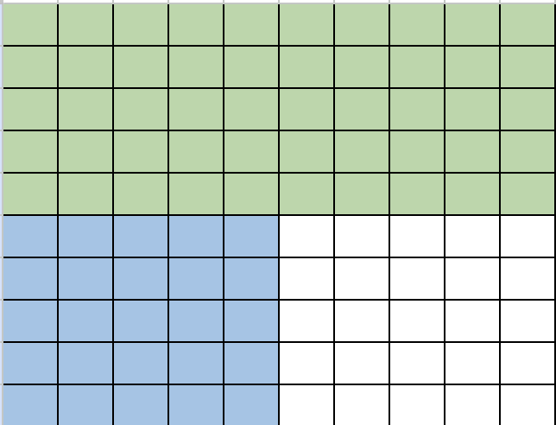
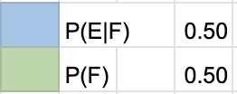
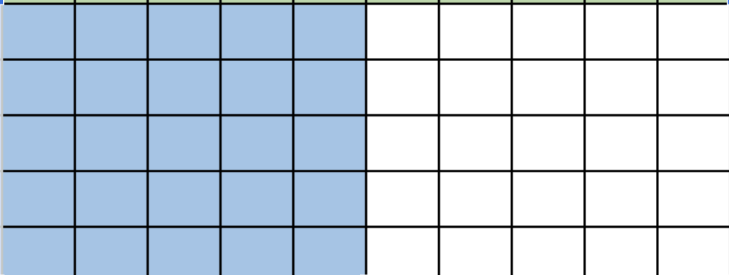
Multiplication Rule: P(E given F)
= P(E|F) * P(F)
= .5*.5
= .25

Slide 7
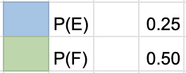
Special Multiplication Rule: P(E and F)
= P(E) * P(F)
= .25*.5
= .125

